Slide 1
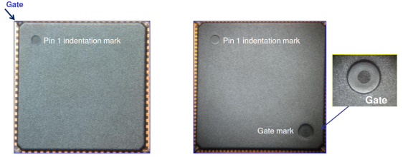
14x14 Mold Compound & Mold Gate Position Change
Change Item | AK1 | AP1 | Reason for Change
14BD Mold Compound | Sumitomo G700L | Sumitomo G631HQ | AP1 standard
14x14 Mold Gate Position | Package corner | Package top side, opposite corner of Pin 1 mark | AP1 standard
AK1 Example
AP1 Example

